Slide 1

Scheduling and deadlock visualization
AKATSUKI
“To Calculate the process in a easy peasy way ”

Slide 2
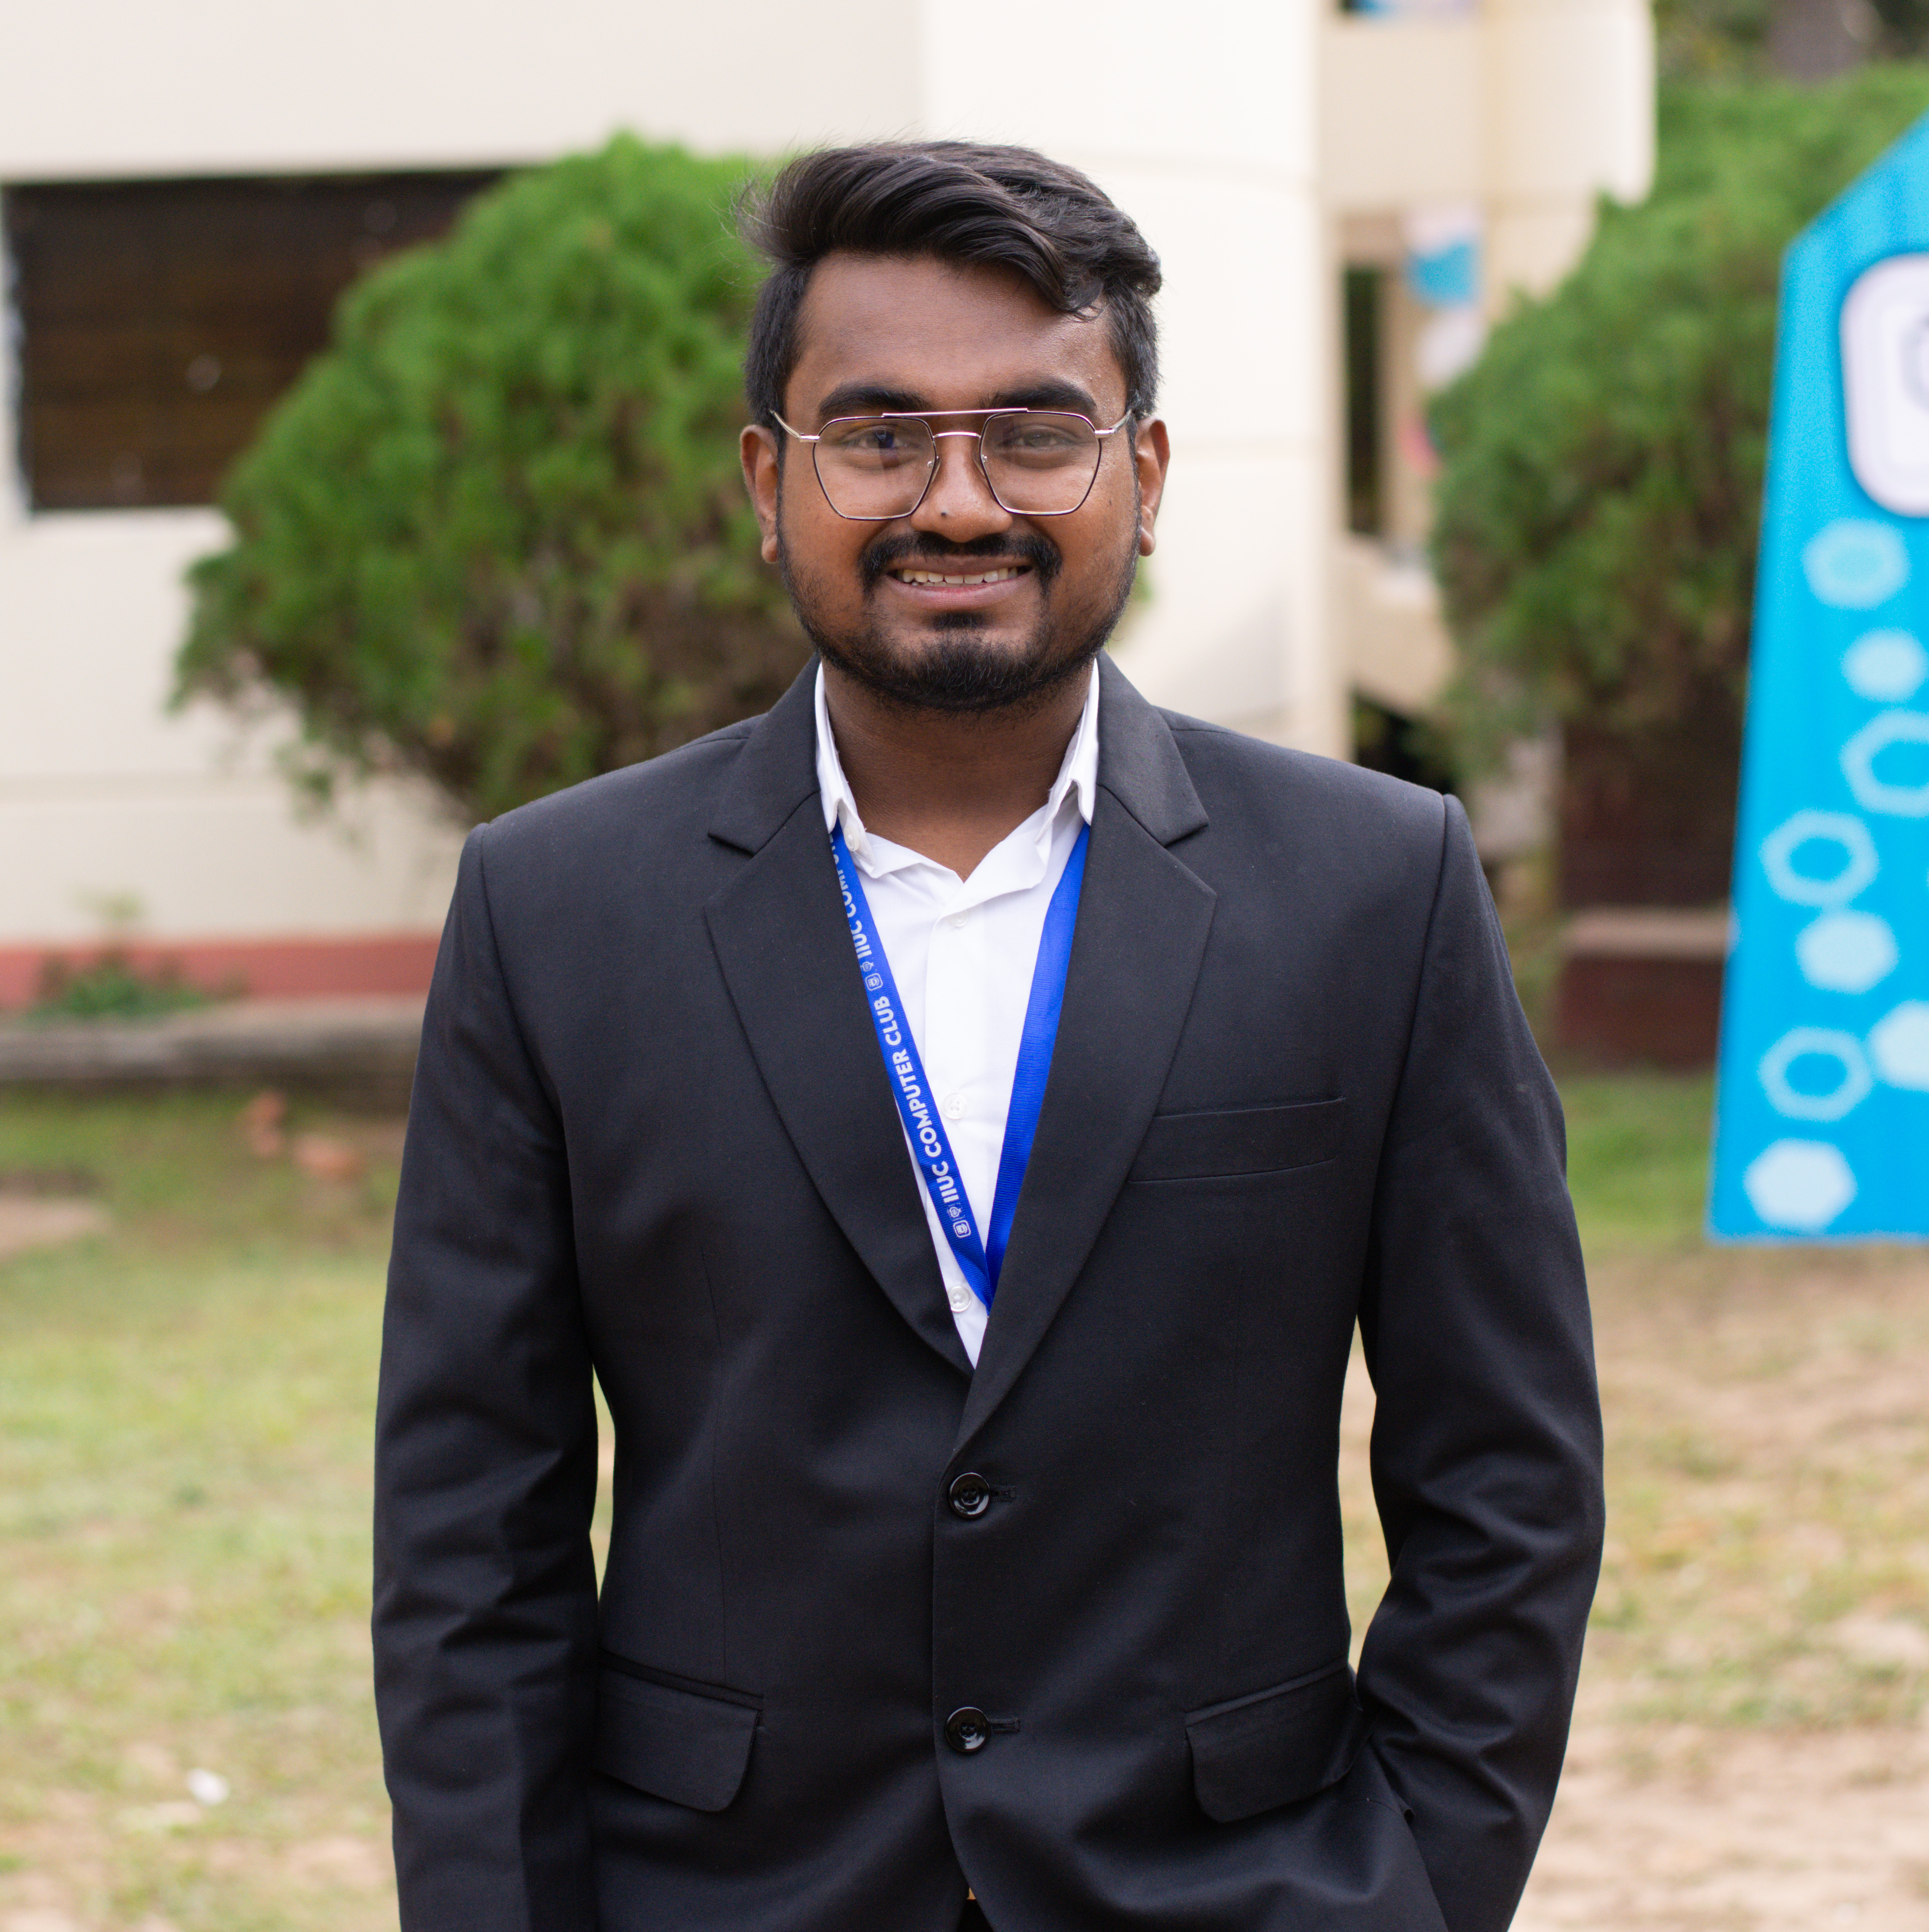


MEET OUR TEAM
SYED MOHIUZZAMAN
PRANAB BARUA ARTHI
AYAT ULLAH
C201070
C201050
C201073

Slide 3
GOALS OF PROJECT
To visualize and determine the Deadlock situation using Banker’s algorithm in operating system.
To visualize the Round Robin algorithm and understand its context switching nature.
To understand the basic First Come First Serve (FCFS) scheduling.

Slide 4





Project Related Software & languages
HTML
CSS
Java Script
Visual Studio
Github

Slide 5
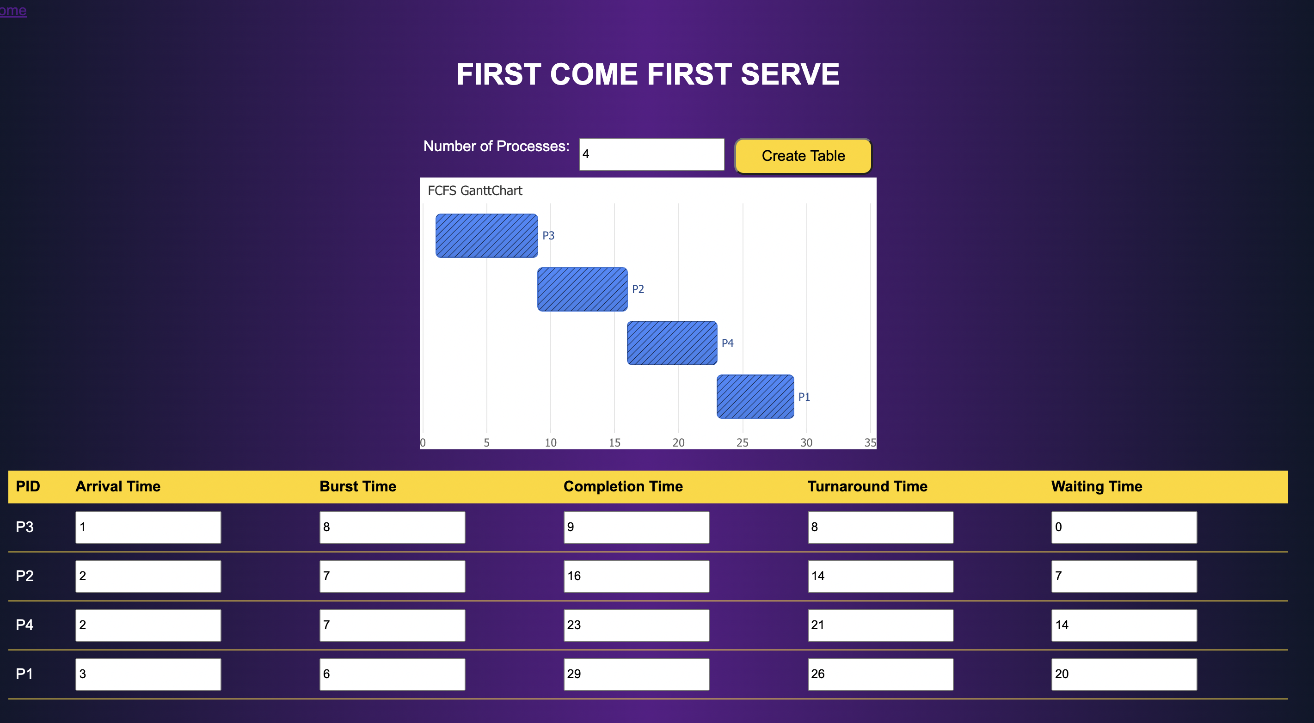
Project Interface

Slide 6
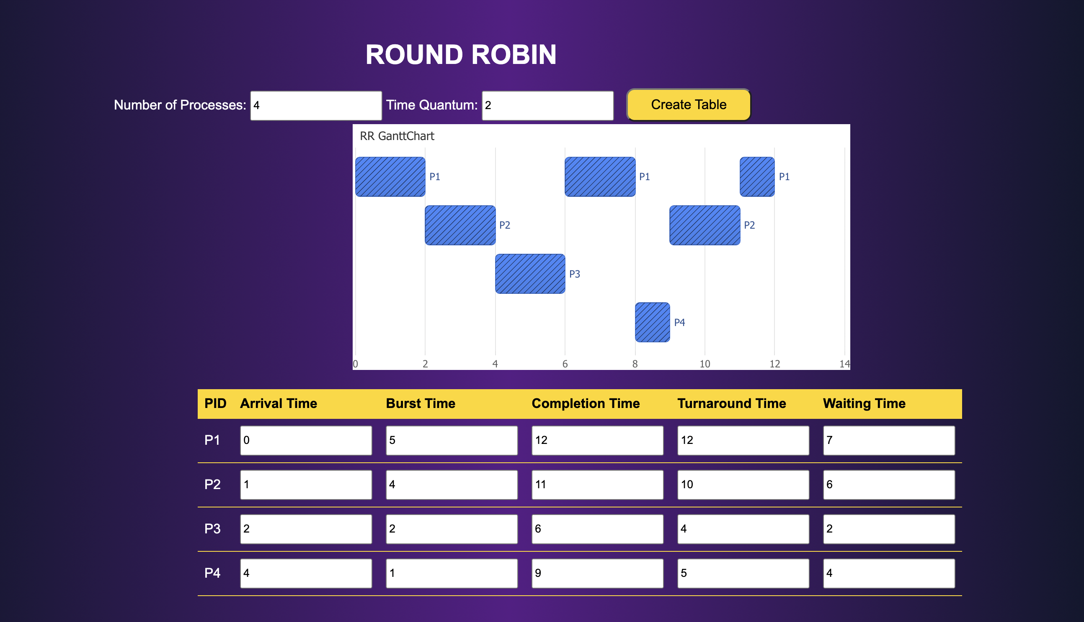
Round Robin Interface

Slide 7
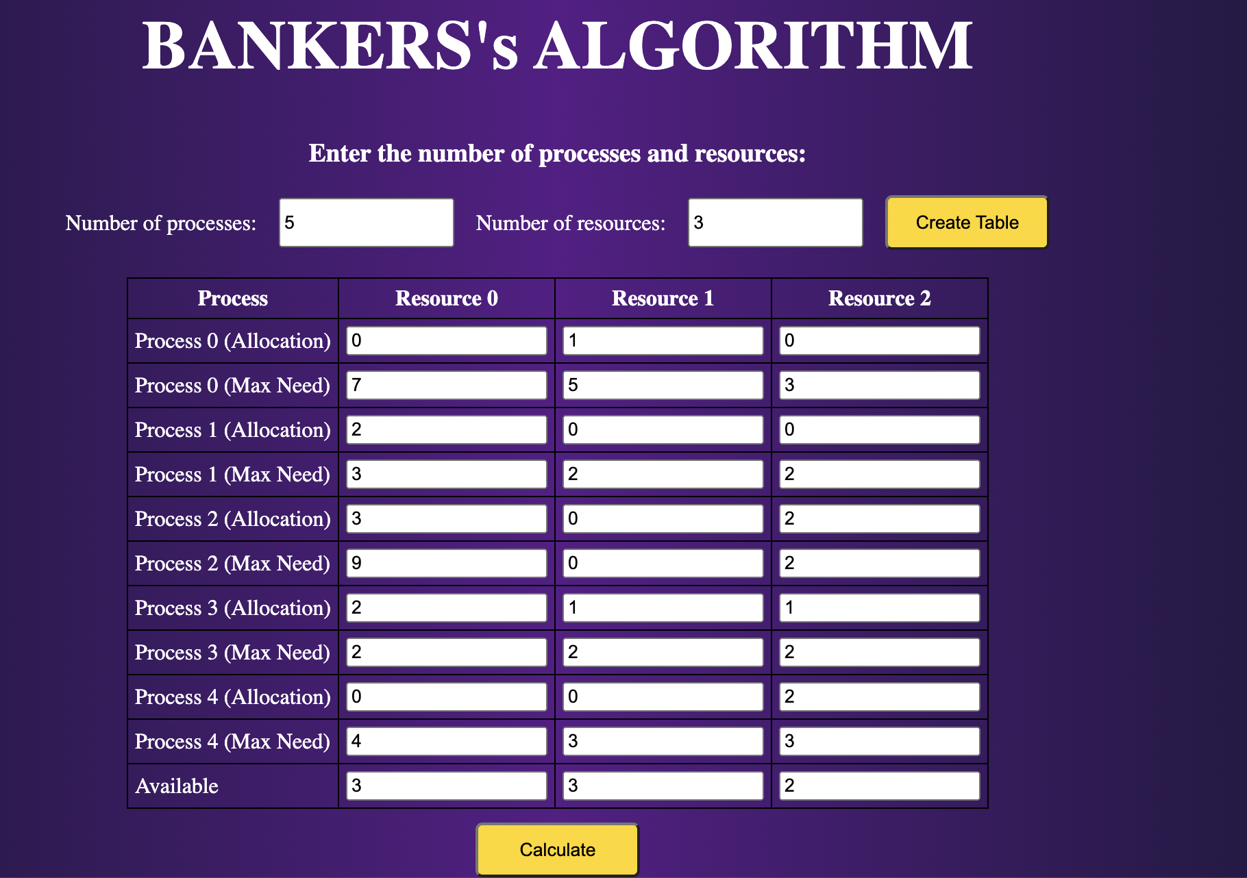
Bankers Algorithm

Slide 8
CONCLUSION
1
We are trying to visualize different algorithms of Operating System. Through this visualization we can understand how operating system works on different circumstances
2
This project will helpful for respective course teacher to make student understand this kind of algorithms which are used in OS with visualation and also student will understand these topic frequently.

Slide 9
THANK YOU
“War will never cease to exist”

